Slide 1
Project Review On Food Ordering System using Core Java
By Bhavesh Chavda

Slide 2
Name : Chavda Bhavesh P.
Enrollment Number : 21162101002
Branch : CBA
Batch No. 31

Slide 3
Outline
Introduction
Problem Statement
Features
Advantages
Requirement
Project Output
Conclusion

Slide 4
Introduction
Many restaurants that still using traditional ordering system will face few difficulties and problems such as ugly handwriting of waiter, give wrong bill payment to customers, etc
All of these problems will cause the dissatisfaction towards the services of the waiter and the restaurant
Food Ordering System is an Console based project which help restaurant to optimized and control their restaurants
For the waiters, it is making life easier because they don’t have to go kitchen and give the orders to chef easily

Slide 5
Problem Statement
Many restaurants is storing all of their data in manual way
They have huge number of customers daily. So because large number of customers, they need the help of some features so they can maintain and stores the records accurately
They need system to maintain their day to day transactions, orders and also regular update on records
In the existing system, entering all the details are done manually, it is taking lots of time and also there are chances for mistakes

Slide 6
Features
Decrease the load of the person involve in existing manual system
Simple status and Resolutions
Easy to operate
Work becomes very speedy
Accuracy in work
Easy to update information

Slide 7
Advantages
This system reduces manual works
Makes works easy and faster than current applications
Makes the ordering process easier
Free and cheap marketing
Menu is simpler to manage

Slide 8
Requirement
Software Requirements :
Operating System - Windows
Programming Language - Core Java
IDE - Eclipse J2EE
Hardware Requirements :
Processor - Intel i3 and above
Ram - 128 MB
Hard Disk - 50 GB

Slide 9
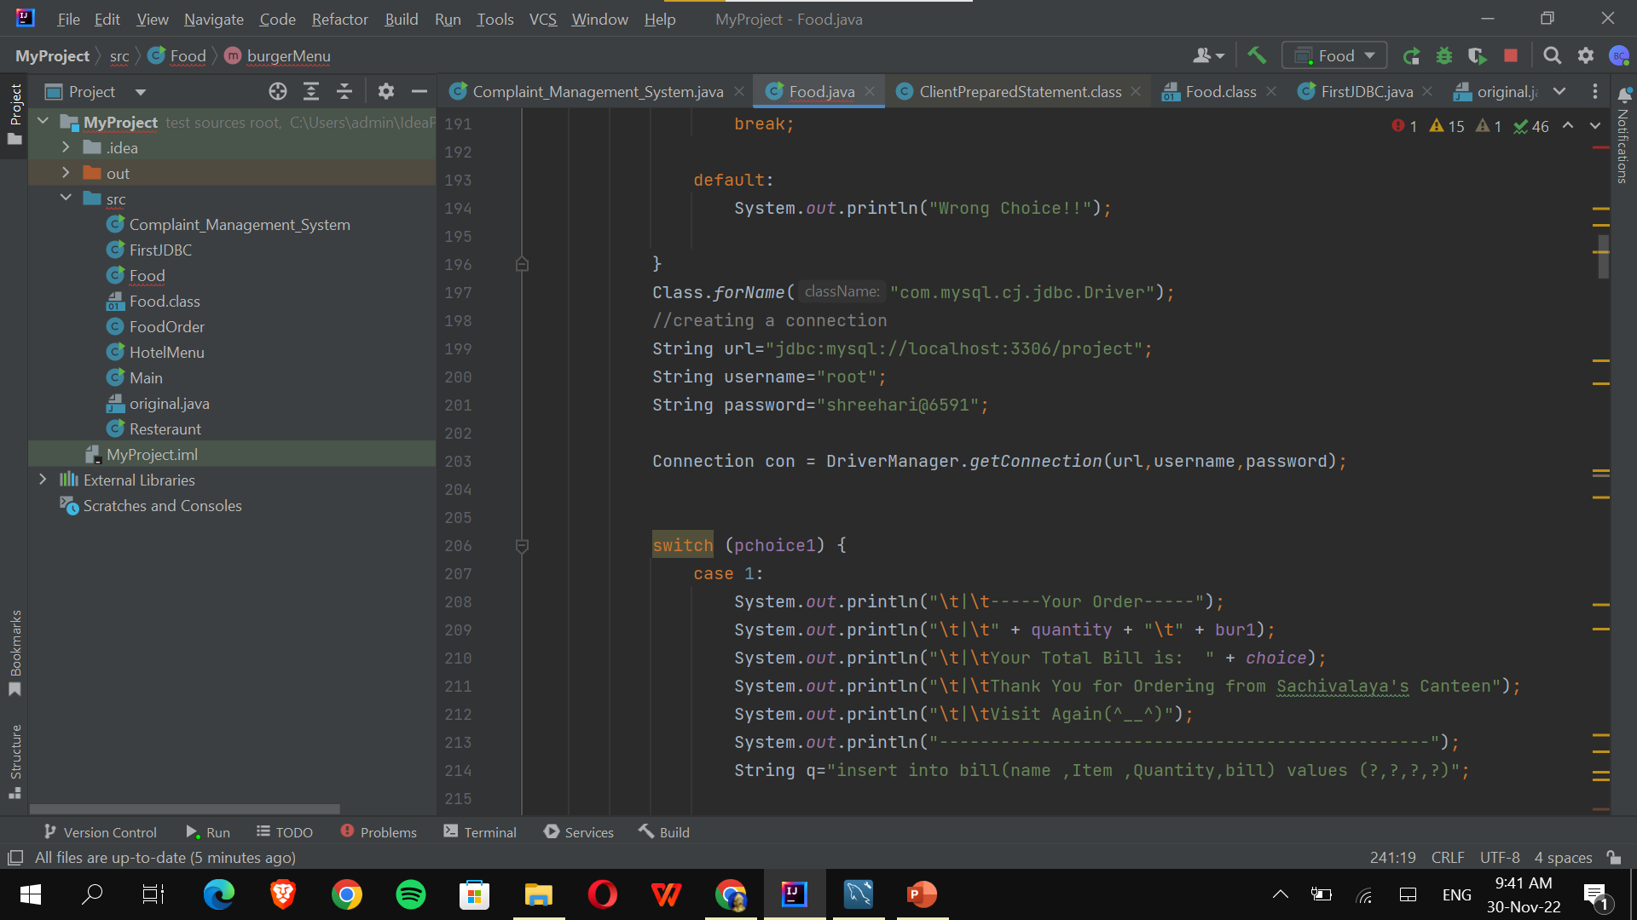
INPUT :
JDBC connection

Slide 10
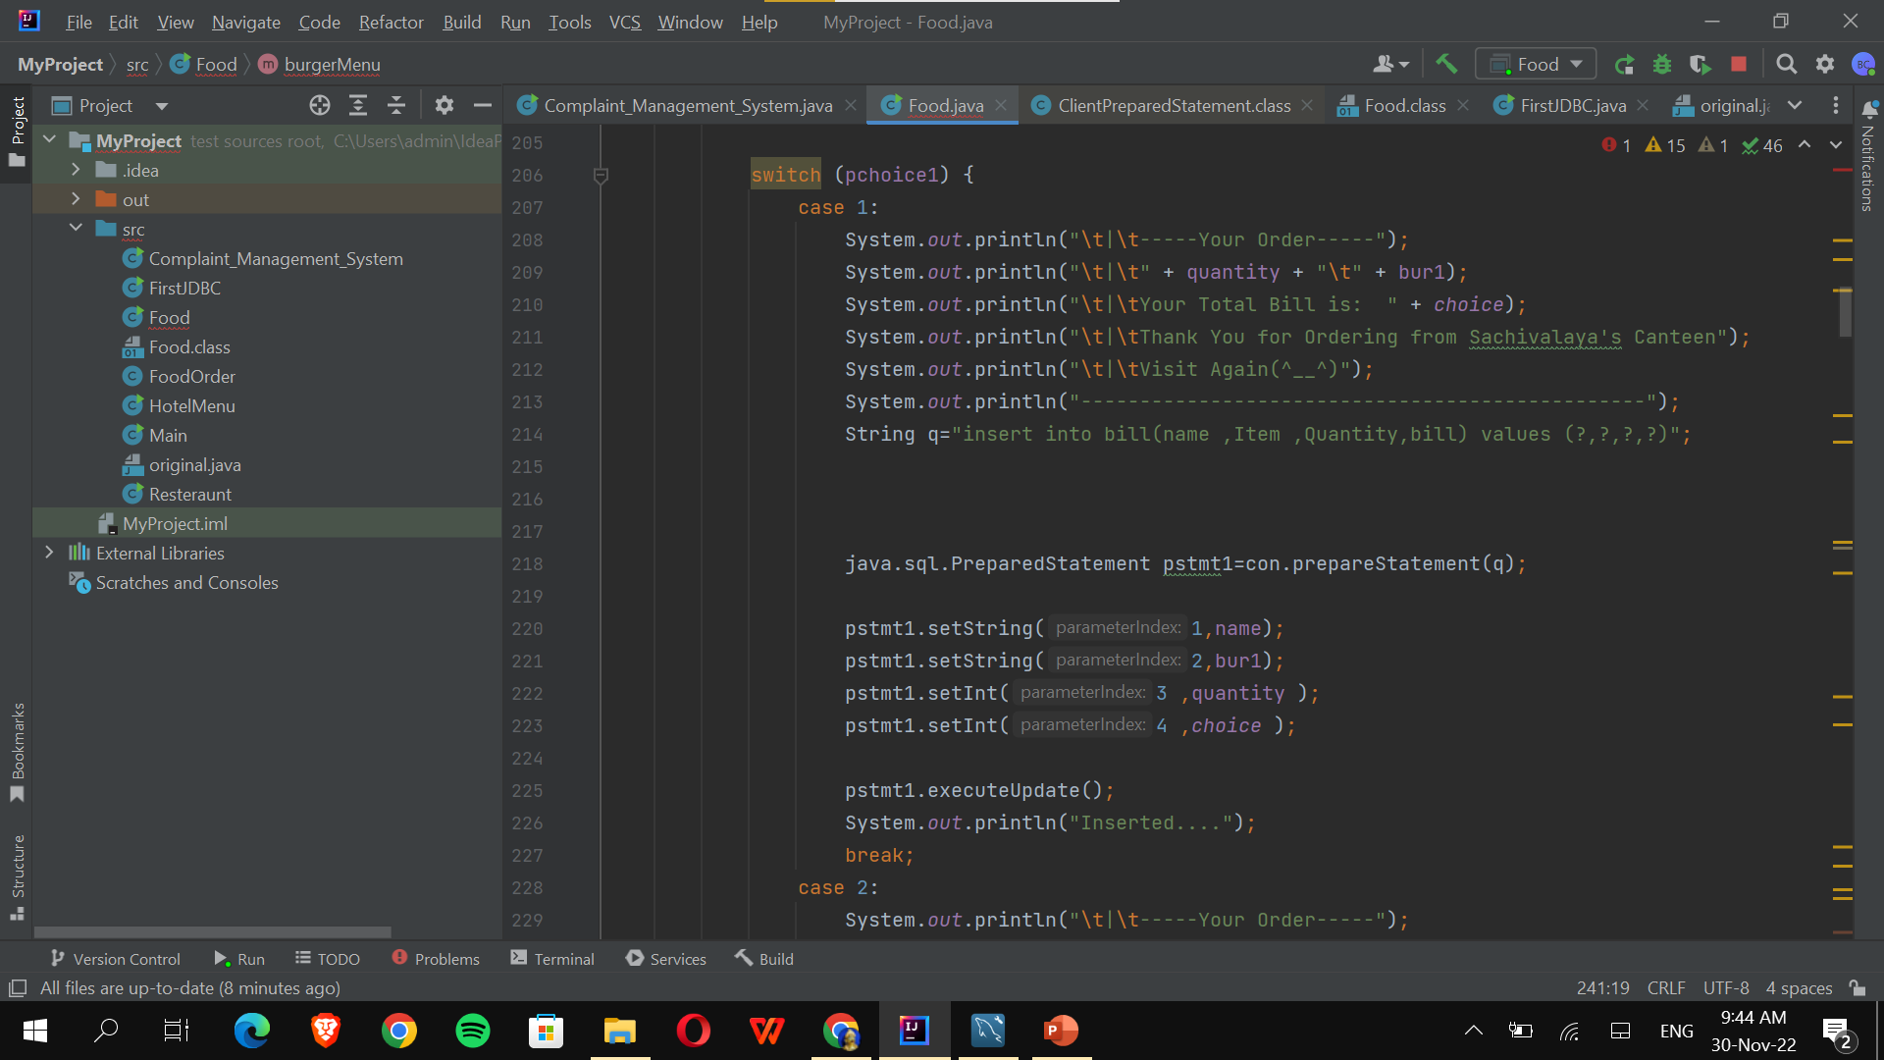
JDBC Connection

Slide 11
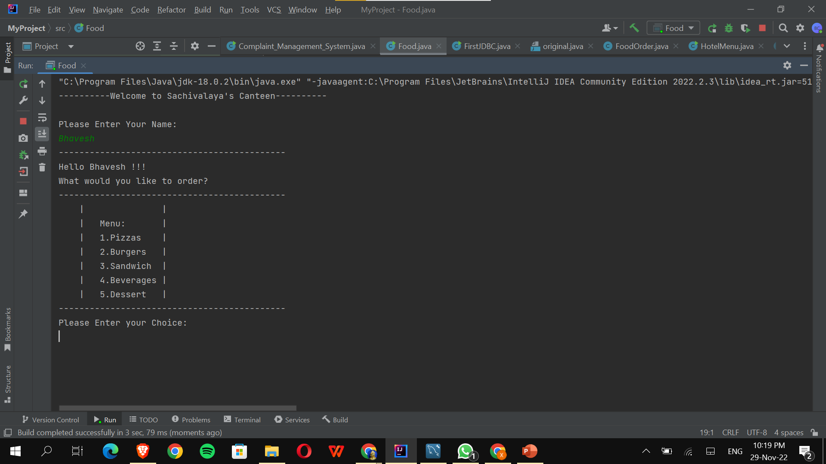
Project Output

Slide 12
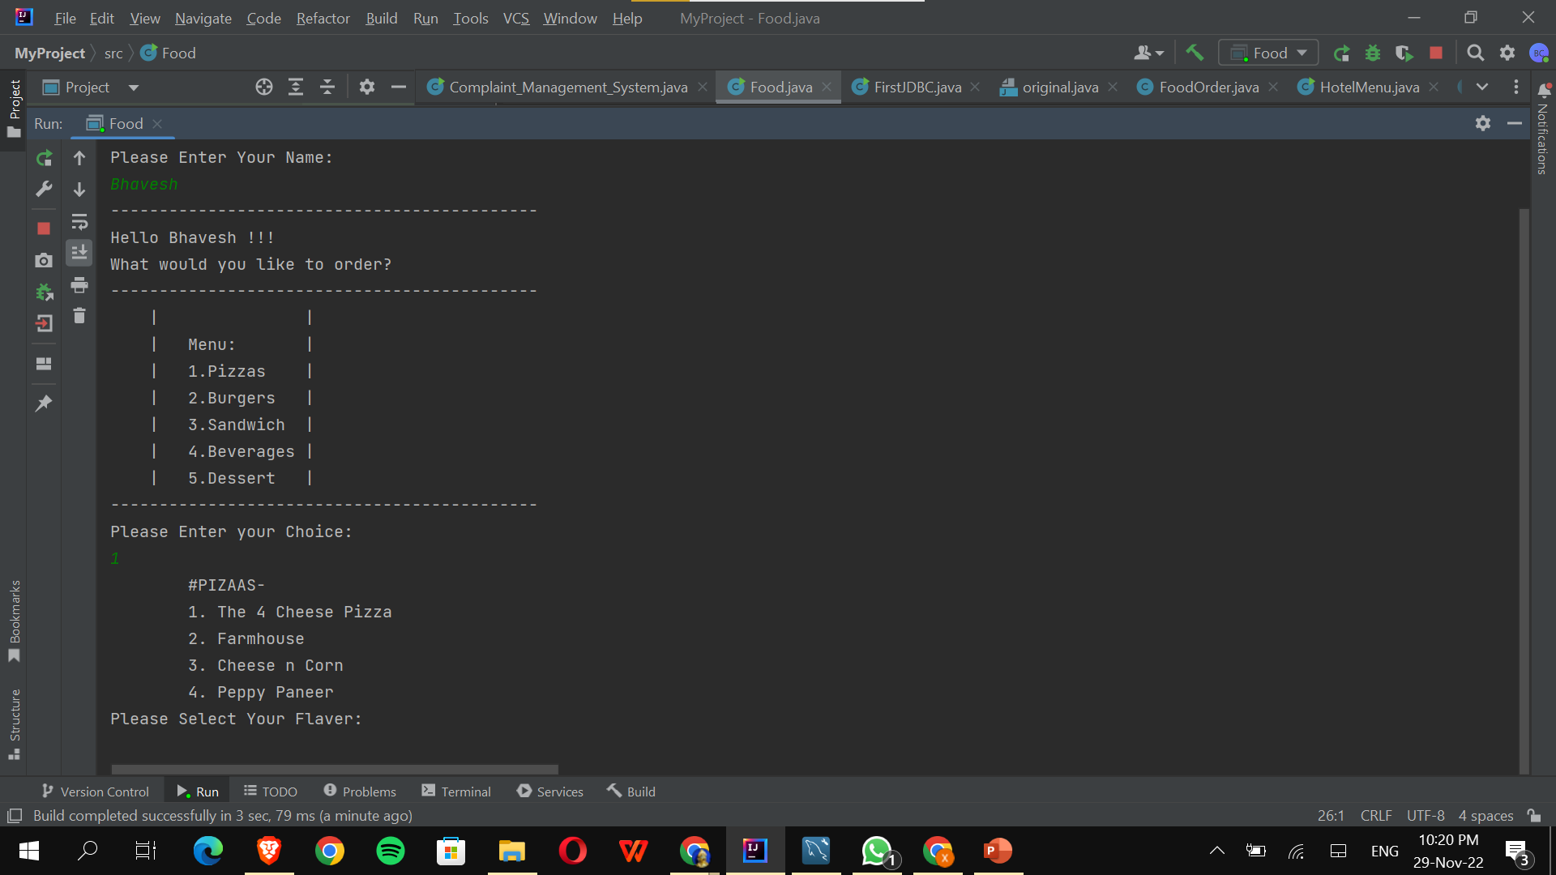

Slide 13
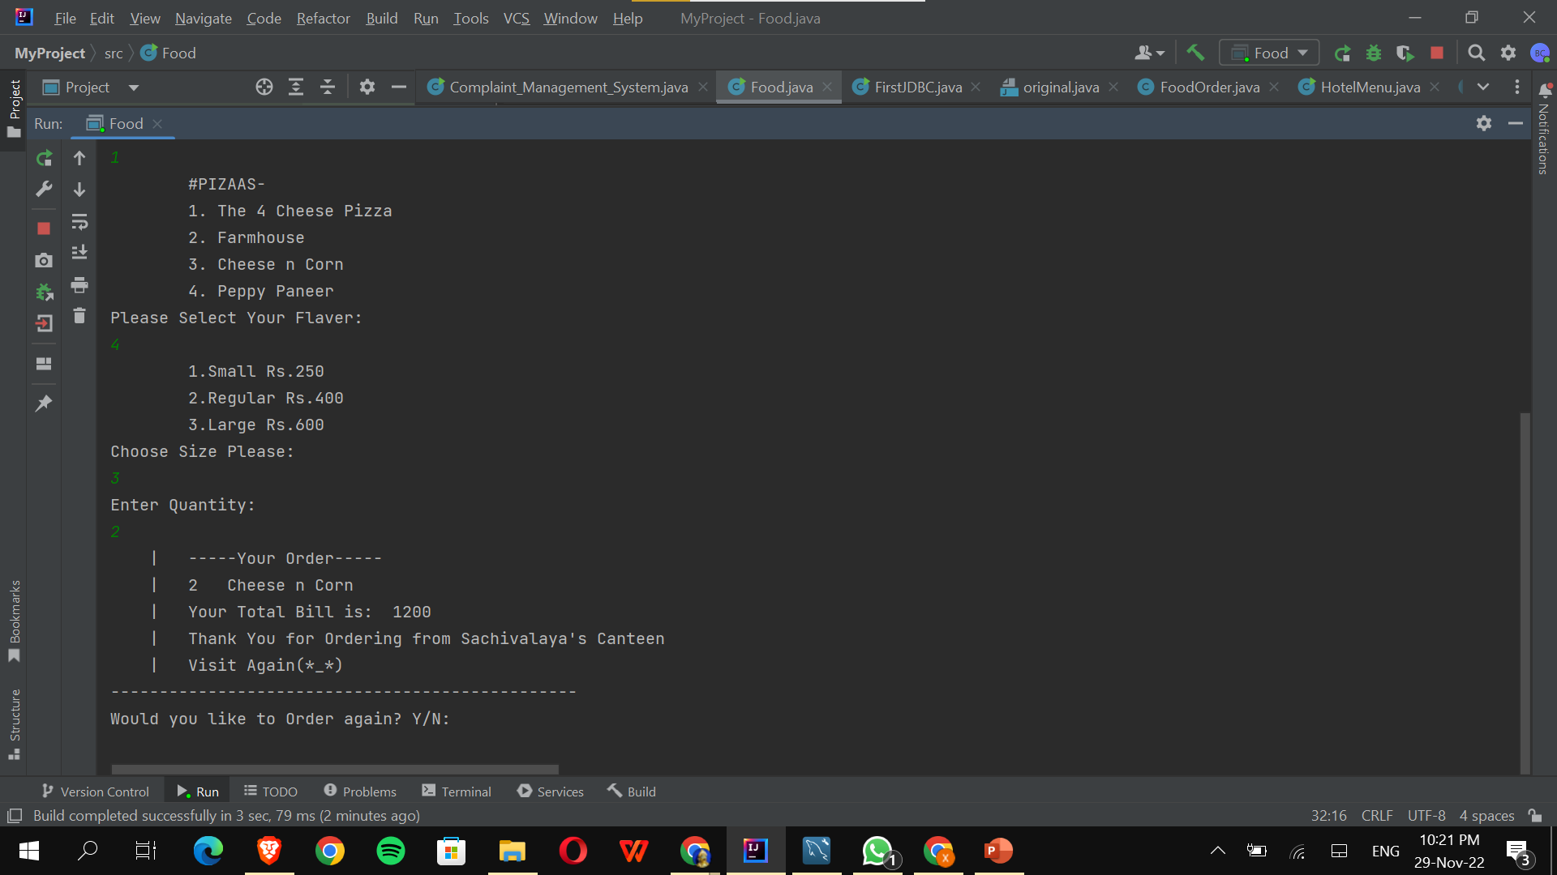

Slide 14
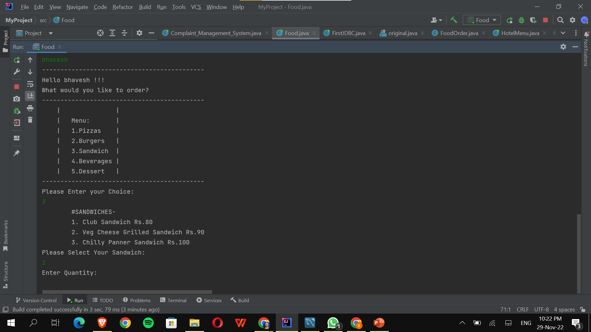

Slide 15
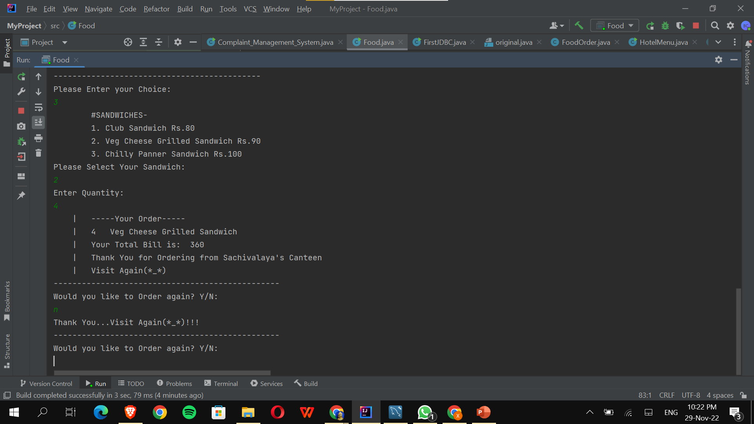

Slide 16
Conclusion
This system allows customers to make their order without wasting time
They can view the menu and make the order and do not need to wait to be served

Slide 17
Thank You

